Slide 1
Measuring informal employment in Household surveys
Michael Frosch
frosch@ilo.org
Department of Statistics
ILO

Slide 2
Four aspects needs to be addressed in the questionnaire
  Identify employment
  The sectors
  Status in employment
  Informal employment

Slide 3
Four aspects needs to be addressed in the questionnaire
  Identify employment
  The sectors
  Status in employment
  Informal employment

Slide 4
    Informal employment and informal sector is aligned to the concept of employment as defined by 19th ICLS resolution.
    It only includes activities mainly intended to generate pay or profit.
    This is typically covered initially in the questionnaire by the use of several questions.
Employment
ATW_1 Last week, from [DAY] up to [DAY] did (you/NAME) work for someone else for pay, for one or more hours? | 1. YES ⟶ MJJ_1 2. NO
ATW_2 Last week, did (you/NAME) run or do any kind of business, farming or other activity to generate income? | 1. YES ⟶ AGF_1b 2. NO READ IF NEEDED: For example: [making things for sale, growing produce for sale, buying and reselling things, provided services for pay, raising animals or catching fish for sale]
ATW_3 Last week, did (you/NAME) help in a family business or farm? | 1. YES ⟶ AGF_1b 2. NO
Module ABS: Temporary Absence
ABS_1 Even though (you/NAME) did not work, last week did (you/he/she) have a paid job or a business? | 1. YES 2. NO

Slide 5
Employment
              For some activities (agriculture) there is a need to set the boundary between production mainly intended to be sold versus mainly intended to be for own-final use.
By correctly set the boundary for employment, as defined by the 19th ICLS resolution, we automatically set the boundary of market production for defining the informal sector
Employment: Within the scope for informal employment and informal sector
OUP-work: Outside the scope for informal employment and informal sector

Slide 6
Four aspects needs to be addressed in the questionnaire
  Identify employment
  The sectors
  Status in employment
  Informal employment

Slide 7
Informal sector
    For the purpose of informal employment, it is sufficient to collect informal sector for:
              Independent workers
                Employers and own-account workers (independent workers without employees)
    But the type of economic unit (informal/formal/household) is an important analytical variable for all employed and useful for policymaking.
              It is strongly recommended to categorize all persons in employment according to the sector.
              Independent workers
                Employers and own-account workers (independent workers without employees)
              Dependent workers
                Dependent contractors, Employees and CFW

Slide 8
Key questions to measure the informal sector
  Intended destination of the production
  Exclude production for own-final use (Households producing for own-final use)
Owned or controlled by the government
  Government and public sector units
Incorporation
  Is the enterprise incorporated or not
Registration
  Registered enterprises/unregistered enterprises
Bookkeeping
  Keeps complete accounts/does not keep complete accounts
Economic units with formal employees are formal
  The economic unit is a formal economic unit if the employee is formal

Slide 9
Questions (ILO MQ), Institutional sector
Formal sector
HOC-sector

Slide 10
Questions (ILO MQ), Registration
Needs to be adapted to national context, and exemplify the question with one relevant example
If we want to reduce respondent burden, we can use registration only as part of defining informality, (as incorporated enterprises are registered.)
But still include incorporation as it is important for ICSE-18.
Formal sector

Slide 11
Questions (ILO MQ), Bookkeeping
Category 2 only relevant in some countries
Formal sector
Informal sector
And if don’t know in main criteria (Registration and Bookkeeping) use an alternative approach (Fixed premises or not, size of the economic unit).

Slide 12
Economic units with formal employees are formal
    If an employee with a formal job; then formal sector.
              Based on the questions defining formal and informal jobs for employees
    .

Slide 13
Four aspects needs to be addressed in the questionnaire
  Identify employment
  The sectors
  Status in employment
  Informal employment

Slide 14
Status in employment
    Is a key aspect as it determines the operational definition of informal employment
              Independent workers
                Direct link between the definition of the informal/formal status of the enterprise and the informal and formal status of the job.
              Dependent workers
                Additional criteria are needed
    We need to separate between:
              Independent workers
              Dependent contractors
              Employees
              Contributing family workers

Slide 15
Use status in employment as the starting point
Either self-declared (ICSE-93) or derived (ICSE-18) (based on multiple questions)

Slide 16
Four aspects needs to be addressed in the questionnaire
  Identify employment
  The sectors
  Status in employment
  Informal employment

Slide 17
The link between formal/informal jobs, informal/formal sector and ICSE
Independent workers
Employers own-account workers
Dependent workers
Dependent contractors, CFW, Employees
Contributing family workers
Employees
Dependent contractors
Household
Producing for own final use
Informal enterprise
Informal sector
Formal enterprise
Formal sector
Informal jobs
IE
Formal job
FE
Informal job
IE
Formal job
FE
Informal jobs
IE
Formal job
FE
Informal job
IE
Formal job
FE
Informal enterprise
Informal sector
Formal enterprise
Formal sector
Informal enterprise
Informal sector
Formal economic unit
Formal sector
Household
(E.g. domestic workers)
Household sector
Informal enterprise
And not registered
Informal sector
Formal enterprise or registered
Formal sector
Outside employment and hence outside IE
For independent workers no further questions are needed. If an informal enterprise; then an informal job.
If a formal enterprise; then a formal job
For dependent workers additional questions are needed

Slide 18
Informal employment; dependent workers
  Dependent contractors
  Employees
  Contributing family workers

Slide 19
Dependent contractors
A) Formal status as workers in employment for profit:
              Whether they have a formal enterprise;
              -Based on the questions determining the informal/formal sector
              If not; whether they are registered in relation to tax on profits.
B) Additional criterion of own contribution to social insurance, to ensure a coverage of formal arrangements:
Example from ILO pilot, Uganda
Needs to be adapted to national context, and exemplify the question with one relevant example.
Example from a pilot conducted by Mexico

Slide 20
Deriving informal/formal jobs for DC
Is the DC registered?
In practice coverage of formal arrangments?
Yes
Business register
Additional criterion of contributions to social insurance
Formal job
in the formal sector
No
Yes
Yes
Registration in relation to profits
Informal job
In the informal sector
No
Informal job
in the formal sector
No

Slide 21
Informal employment; dependent workers
  Dependent contractors
  Employees
  Contributing family workers

Slide 22
Employees
    The 21st ICLS resolution provides stronger recommendations on the criteria to use and how to combine them.
              Employers' contribution to social insurance –A prioritized criterion.
              Access to paid annual leave and paid sick leave - Relevant criteria.
              Additional national characteristics - Supporting criteria:
                Exactly how they are integrated in the definition would depend on the specific criteria and the country context.

Slide 23
Main questions for employees;
For most countries
Needs to be adapted to national context, and exemplify the question with one relevant example
Formal job
Informal job
Access to both then formal job
Access to one or none then informal job

Slide 24
Informal employment; dependent workers
  Dependent contractors
  Employees
  Contributing family workers

Slide 25
Contributing family workers
    In countries where no formal arrangements are in place for CFW.
              By default informal jobs.
    In countries that have formal arrangements for CFW.
              Whether the family business is informal or formal.
              -Based on the questions determining the informal/formal sector
              Informal family business=informal job.
              Formal family business then;
              Registration and contribution to social insurance.
Formal job
Informal job

Slide 26
So lets put it all together...

Slide 27
Questions for the three sectors
All jobs independent on status in employment
Questions
(Market production)
Institutional unit
Registration
(Incorporation)
Bookkeeping
Informal sector
Formal sector
HOC-sector

Slide 28
Questions for informal employment
Independent workers/ employers own-acount workers
Employees
CFW
DC
Questions
(Market production)
Institutional unit
Registration
(Incorporation)
Bookkeeping
Questions
Contribution to social insurance
Access to paid annual leave
Access to paid sick leave
Questions for the informal/formal sector
Contributions to social insurance
Questions for the informal/formal sector
And
Registration for tax on profits
Contributions to social insurance
Informal Job
Formal job
Informal Job
Formal job
Informal Job
Formal job
Informal Job
Formal job

Slide 29
Integrate the questions in a survey
Market production (Employment)
Self-declared status in employment
Questions to derive ICSE-18
Institutional unit
Dependent contractors
Registration
Incorporation
Account keeping
Dependent contractors
Registration for profit.
Contribution to social insurance
Dependent contractors
Self-employed
Independent workers
Independent workers
CFW
CFW
Contribution to social insurance
CFW
CFW
Those with informal jobs working for a farm or private enterprise
Institutional unit
Employers contribution to social insurance
Access to paid annual leave
Access to paid sick leave
Employees
Employees
In the end the exact flow of questions will depended on the structure of the questionnaire, existing questions, filters and skips

Slide 30
In summery
    By using a few set of questions, it is feasible to identify the three different sectors and informal and formal employment.
    Can be disseminated using all other data collected (ISCO; ISIC; ICSE-18, other job characteristics, demographic characteristics etc.)
    The key issues to address when measuring informal employment/informal sector is the national adaptation of the questions.
              Which national registration(s) would be useful and effective to operationalize the criteria of registration of enterprises and of commercial workers?
              Which national statutory job-related social protection insurance would be relevant to refer to for employees and DC?
              Can CFW register their job and get access to some social insurance?
    This impact on the precise questions to include, as well as the precise formulation of the questions.
    Might be need to have discussions with different stakeholders.
    Can be a technical challenge to integrate them in an already existing survey, but this can always be resolved. And don’t impact on the experience of the respondent.

Slide 31
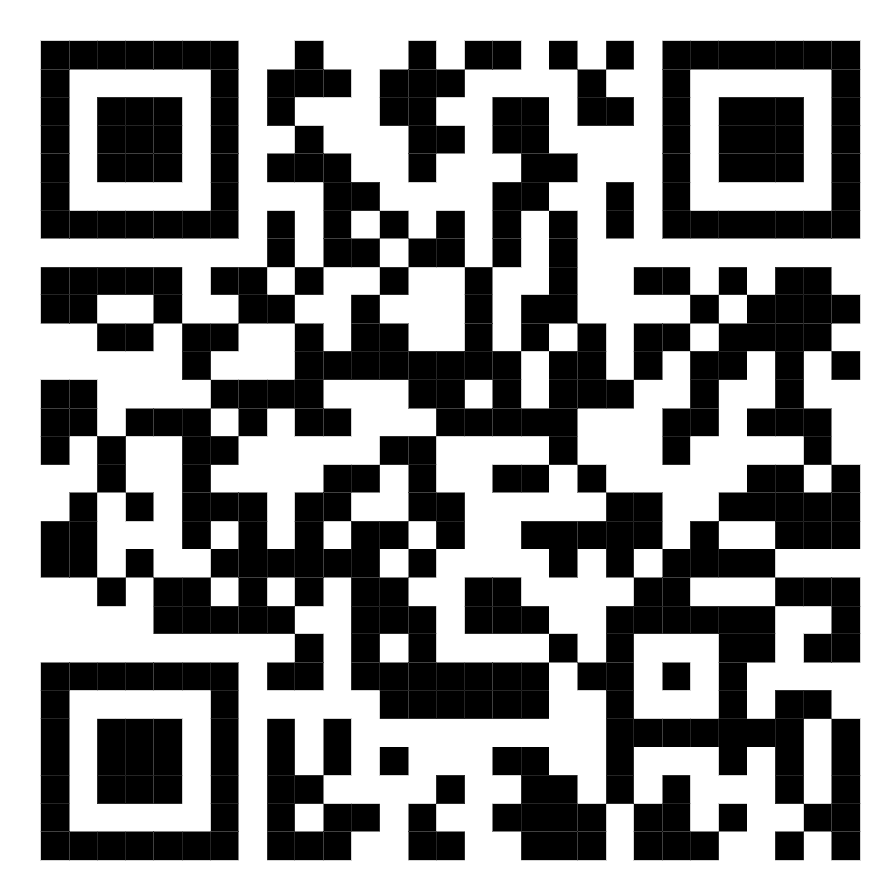
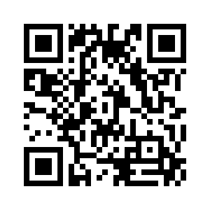
    ILO have tested and developed model questions to be used in HH-surveys.
    This has been integrated in the LFS tools that are provided to users
              Includes a MQ, Derivation guide, National adaptation guide, Syntaxis in STATA, CAPI tools in CSPRO and Survey solutions.
Informal Economy: Resource page
https://ilostat.ilo.org/topics/informality/
LFS Tools:
https://ilostat.ilo.org/resources/lfs-toolkit/

Slide 32
Thank you

Slide 33
Employees- formal/informal nature
Contributions to SI always defines the job as formal
There is the main option:
Define jobs as informal if no contributions are made
and in the case of don’t know define the job as formal if access to paid annual leave and paid sick leave
And finally use additional “national criteria” if relevant
No
Employer’s contribution to social insurance
Yes
Formal job
Informal job
DK
No
Access to paid annual leave
Yes
No
Access to paid sick leave
Yes
Additional “national” criteria

Slide 34
Model flowchart for all non-employees
Intended destination of the production
Producing for own-final use
Not producing for own-final use
Q1. Institutional sector
2. Farm
3. Private business
7,8. Other, DK
Q3. Registration
Registered
2. Not registered at national level
3.Don’t know
Q4. Incorporation
1=Independent on legal form
5.Don’t know
Q5. Bookkeeping
3 Other
1,2,3. Complete accounts
4. Does not keep accounts
Unclassifiable !!!
Own-use production work in the HOC-sector
Works in the informal sector
Works in the formal sector

Slide 35
Model flowchart for all non-employees
Institutional sector
Government, Corporations, NGO, IO etc
Private household
Farm or private business (unincorporated)
Other, DK, NA, Not asked
Registration
Registered at national level
Not registered at national level
Other, DK, NA, Not asked
Book keeping
Keeps accounts for reporting to the Government
Does not keep accounts
Other, DK, NA, Not asked
Households
Yes
Place of work
Other
Non-fixed premises
Q6. Size
6 or more, other
5 or less
Formal sector
Informal sector

Slide 36
Model flowchart for employees
Employees
Q1. Institutional sector
6. Private household
1,4,5
Gov, NGO, IO etc
2. Farm
3. Private business
Formal job
Have a formal job
Have an informal job
Q3. Registration
Employed in the HOC-Sector
Registered
2. Not registered at national level
Q5. Bookkeeping
1,2,3. Complete accounts
4. Does not keep accounts
Works in the informal sector
Works in the formal sector

